Slide 1

Introducing Coherent Systems
Reliable Solutions for Manufacturing
May 2021

Slide 2
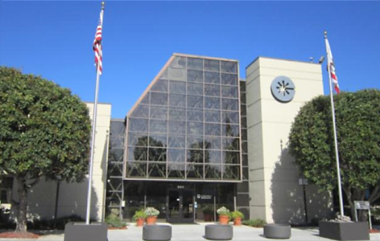
Coherent Key Facts
Coherent is one of the world’s leading providers of photonic solutions. We offer a comprehensive portfolio of components, lasers, laser sub-systems, and laser machines for a broad range of industrial, commercial, and scientific applications.
Corporate Headquarters: Santa Clara, California, USA
Founded in 1966
Sales $1.2 Billion (FY20)
Asia: 63 %; US: 16 %; EU: 18 %; RoW: 3 %
ME: 44 %; MP: 27 %; OEM: 20 %; SCI: 9 %
~4,900 Employees
27 Manufacturing Sites in 10 Countries

Slide 3
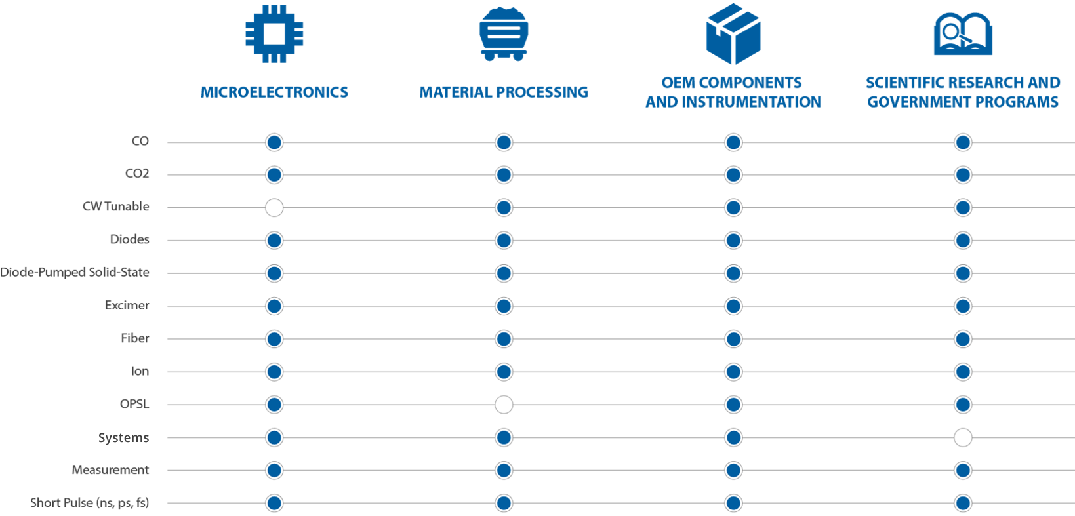




Coherent Key Technologies

Slide 4
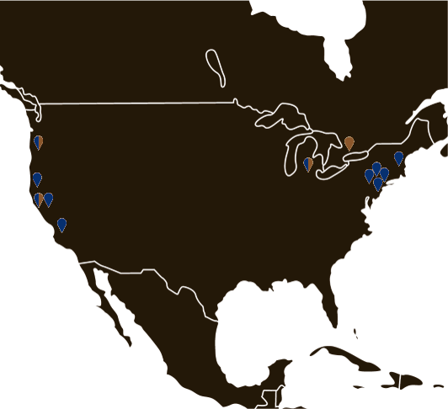
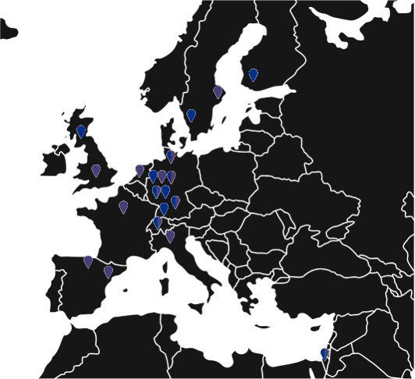
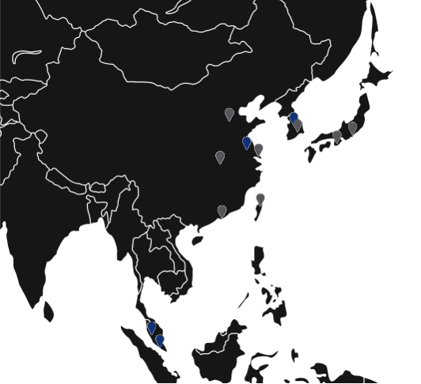
Global Capabilities
North America
Europe
Asia
Santa Clara, CA
Sunnyvale, CA
Richmond, CA
Monrovia, CA
Wilsonville, OR Plymouth, MI
East Granby, CT
Bloomfield, CT
Salem, NH
Landing, NJ
E. Hanover, NJ
Mississauga, ON,
Canada
Tampere, Finland
Belp, Switzerland
Frieburg, Germany
Kaiserslautern, Germany
Hamburg, Germany
Overath, Germany
Dieburg, Germany
Gilching, Germany
Goettingen, Germany
Mainz, Germany
Daventry, UK
Glasgow, UK
Utrecht, Netherlands
Lisses, France
Barcelona, Spain
Pamplona, Spain
Monza, Italy
Molndal, Sweden
Uppsala, Sweden
Pituach, Israel
Taipei, Taiwan
Beijing, China
Shanghai, China
Shenzen, China
Wuhan, China
Nanjing, China
Malaysia
Singapore
Seoul, Korea
Osan, Korea
Osaka, Japan
Tokyo, Japan
Manufacturing
Manufacturing & Sales / Service
Sales / Service

Slide 5
Systems – Global Competence – Local Service
North America
Europe
Gilching
Germany
Belp
Switzerland
Pamplona
Spain
Plymouth
MI

Slide 6

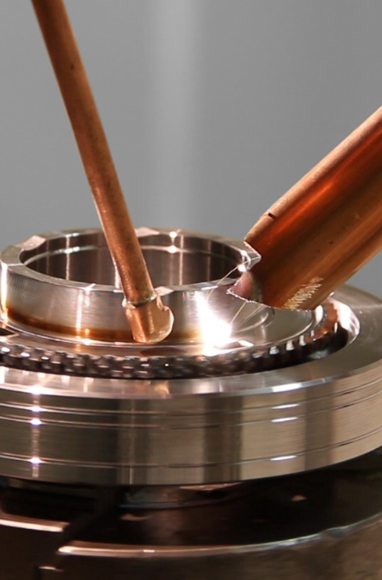

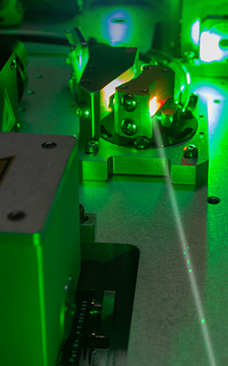
Core Markets for Systems and Sub-Systems
Coherent laser systems and sub-systems make industrial manufacturing most efficient thanks to many decades of machine building competence and underlying application and process expertise.
Microelectronics
(ME)
Materials Processing
(MP)
OEM Components & Instrumentation
(OEM)
Scientific Research & Government Programs
(SCI)

Slide 7
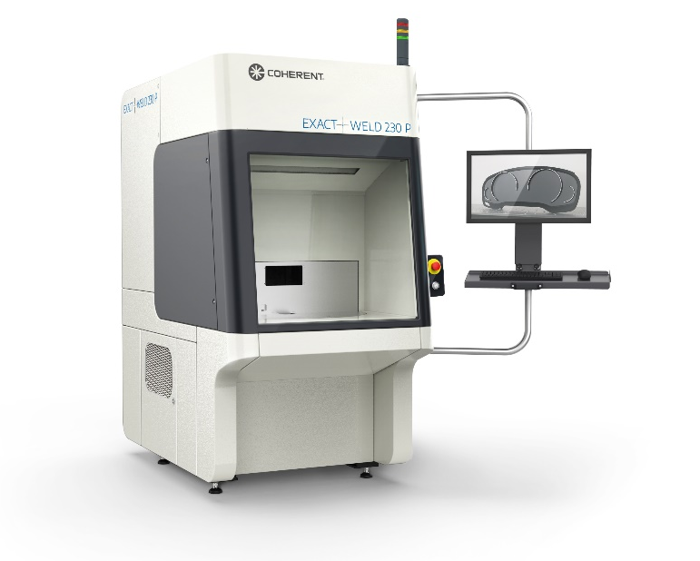
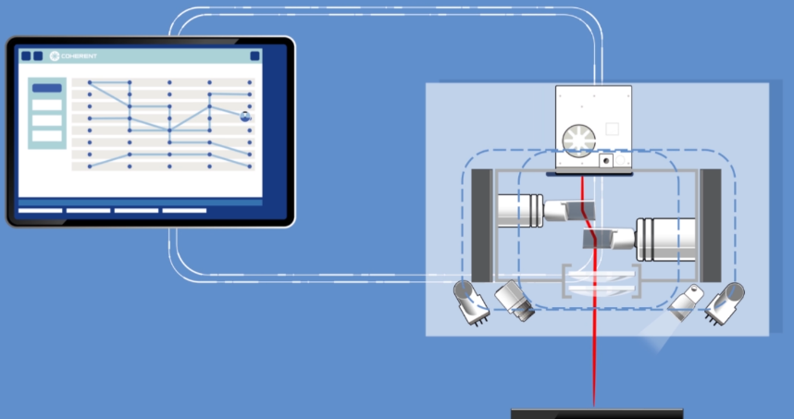
Sub-Systems to Systems – Different Levels of Configuration
Sub-Systems
Systems
Laser combined with one or more:
Beam delivery
Processing heads
Process monitoring, pattern recognition and vision system
Powerful software
Application and process recipe
Laser systems:
Different levels of configuration, including fully automated versions
Powerful software
Application and process recipes
Integrated sub-system

Slide 8


Sub-Systems – Complete Solutions for Integrators
Our sub-systems include lasers, standardized beam delivery components, processing heads and dedicated software for process management - tailored for dedicated applications and customer needs.
Sub-System
Laser
Optical Beam Path
Processing Heads
Laser Control Software
Options
Laser Process Control
Process Monitoring
Vision System
Dedicated Software Options

Slide 9
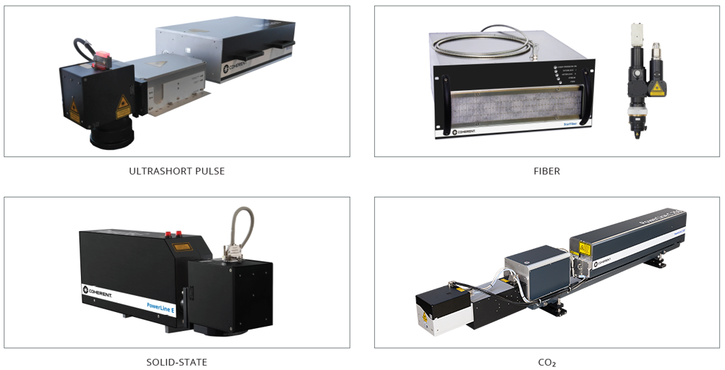
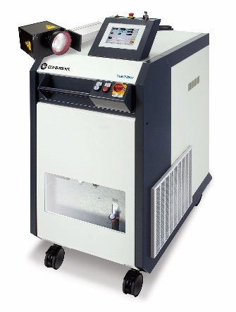
Sub-Systems – Product Families
Available in different levels of configuration
Ultrashort Pulse - Cutting
Fiber – Cutting & Welding
Solid-State - Marking, Structuring
CO₂ - Marking, Structuring, Cutting

Slide 10

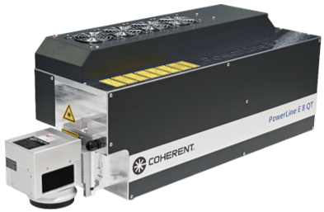

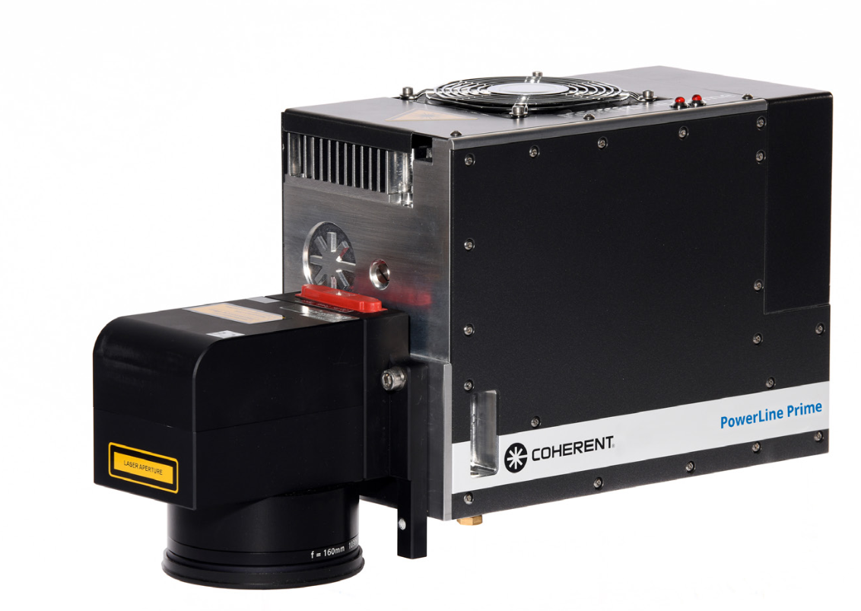
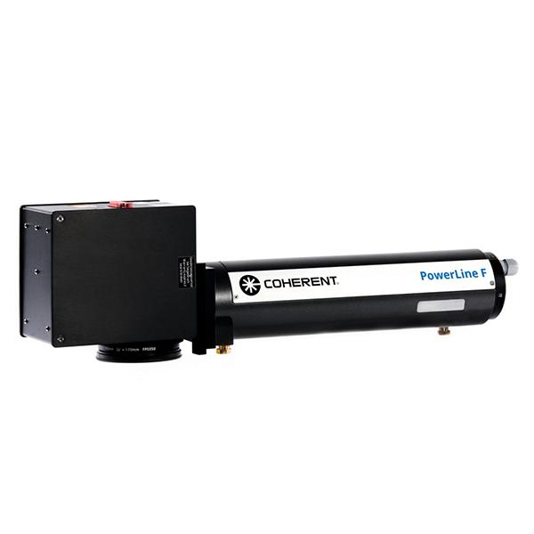

PowerLine Family
Benefits
Broad range of IR, green and UV laser markers
Flexible configuration of sub-systems from high-quality building blocks
19” components, compact dimensions
Doubleheader configurations available
Low operating costs and minimum maintenance
High precision field correction
Power monitoring, internal power sensor, external power meter

Slide 11

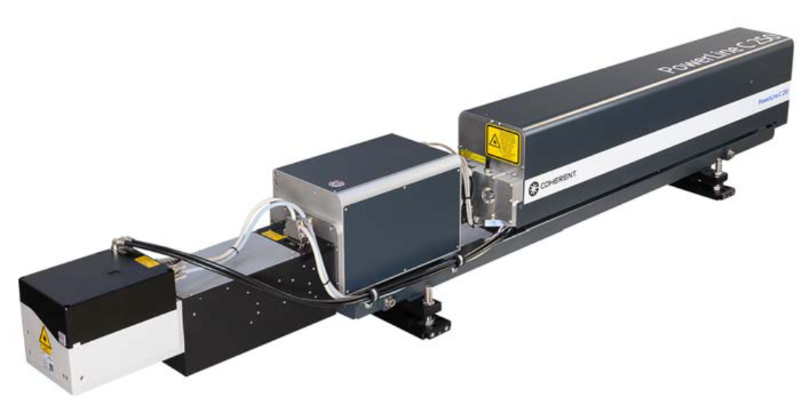
PowerLine C
Benefits
Excellent beam quality
Scanner deflection head technology
Wide spectrum of laser power up to 450 W
Most complex on-the-fly applications possible
19” components, compact dimensions
Low operating costs and minimum maintenance
Available as standard module or stand-alone work station

Slide 12
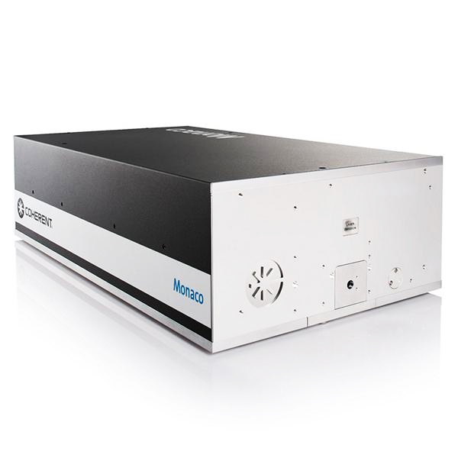
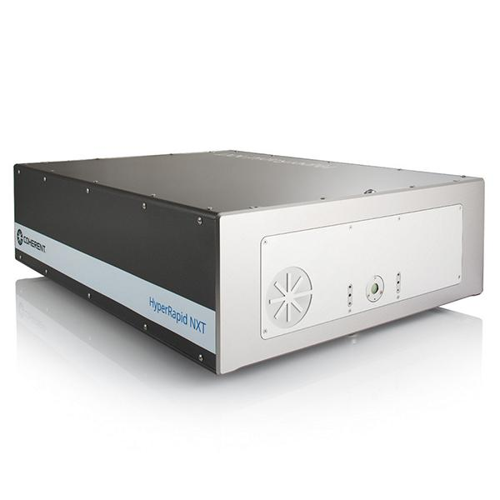
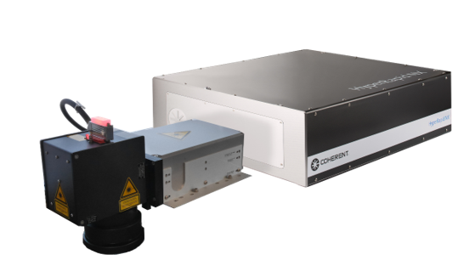
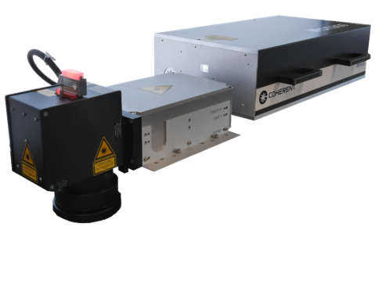
Ultrashort Pulse Family
Benefits
Broad range of IR and green picosecond and femtosecond laser sub-systems
Wide spectrum of laser power from (up to 100 W)
Compact, optimized footprint
Low operating costs and minimum maintenance
One partner for delivery, warranty, service and application support
Save time during machine assembly: tested and startup of full package, ready for machine integration
Speed up time to market by using our developments in software, beam delivery, safety and application support

Slide 13
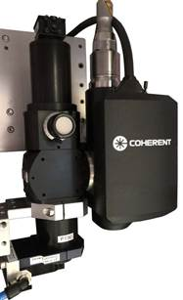
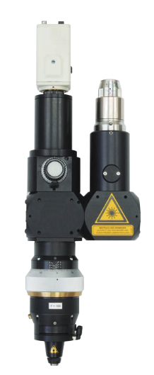

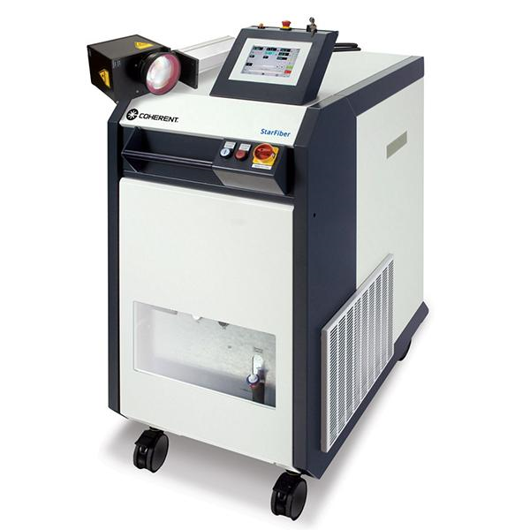
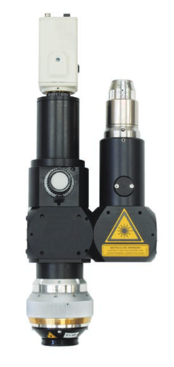
StarFiber Series
Benefits
Compact fiber lasers with optional focusing and scanner heads for laser welding or cutting applications
Various options such as vision and process monitoring
Power up - 100 W to 1500 W (from Q1 2022) lasers available
SmartWeld™and SmartWeld + technology for superior welds
Easy integration into a machine/system environment due to “fit-in & turn-key” integration
Customized solution: Laser source & processing optics, control software, and options
Low operating costs and minimum maintenance
Receiving support by a world-wide service

Slide 14
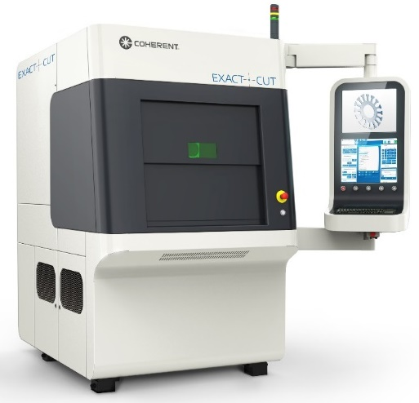
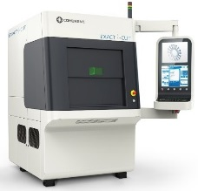
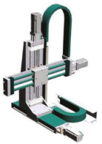
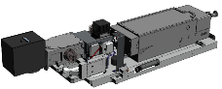
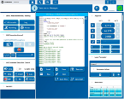
Systems – Turnkey Solutions from a Single Source
Coherent systems include our standard machine platform, standardized components and sub-systems - tailored for dedicated applications and customer needs.
Basic Configuration
Sub-System
Housing
Axis System
HMI
Setup Engineering
Fixture
Application
Electronic
Software
Measurement Eng.
Options
Fixture
Power Measurement
Exhaust System
Barcode Reader

Slide 15
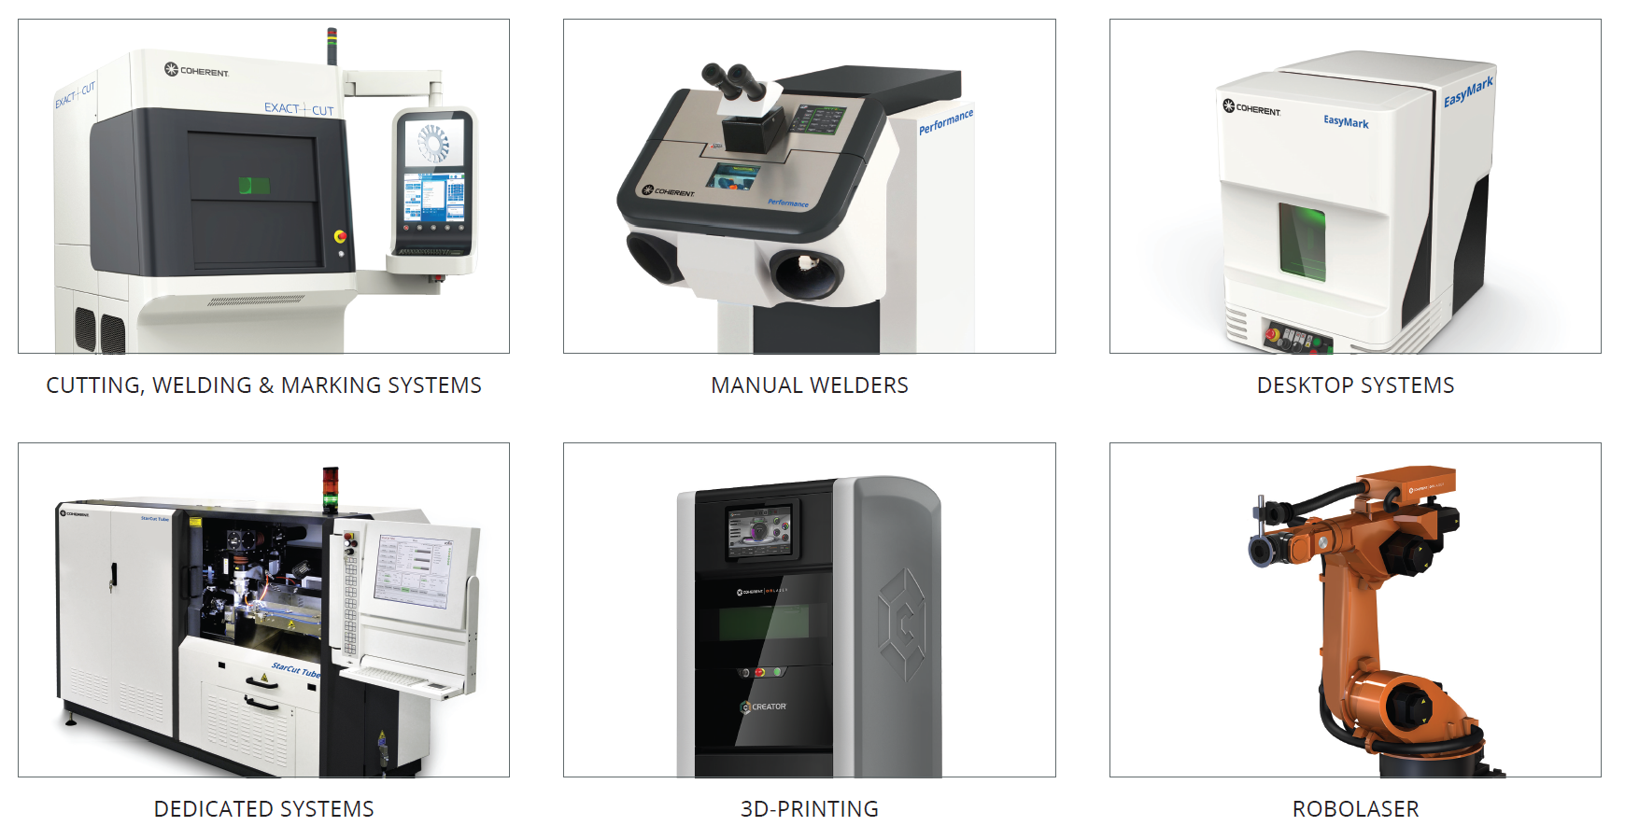
Systems – Product Families
Cutting, Welding & Marking Systems
Manual Welders
Dedicated Systems
Desktop Systems

Slide 16
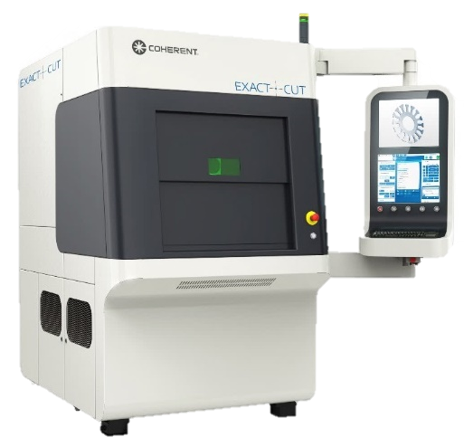
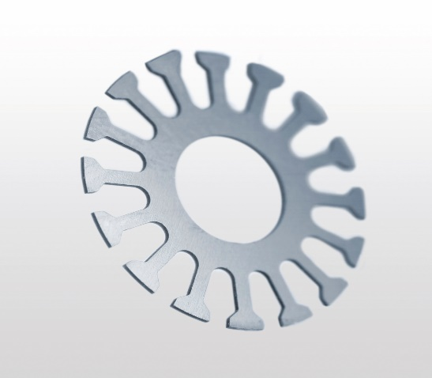
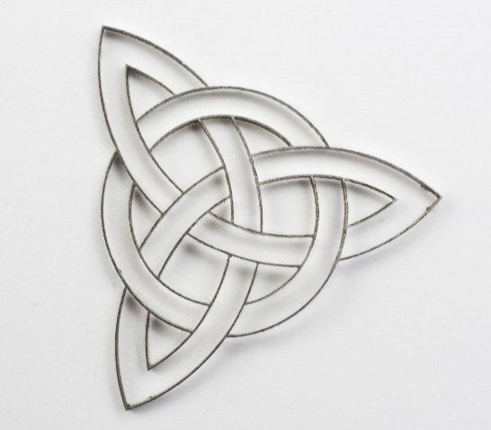
ExactCut – Precision Laser Cutting System
SPECIFICATIONS
Integrated laser source StarFiber P (150 W / 300 W)
High peak power 1.5 kW / 3.0 kW
Most precise cutting head with unmatched stability
Up to 5 Axis
Optional cutting box for precision clamping
Optional CCD camera with integrated crosshair

Slide 17
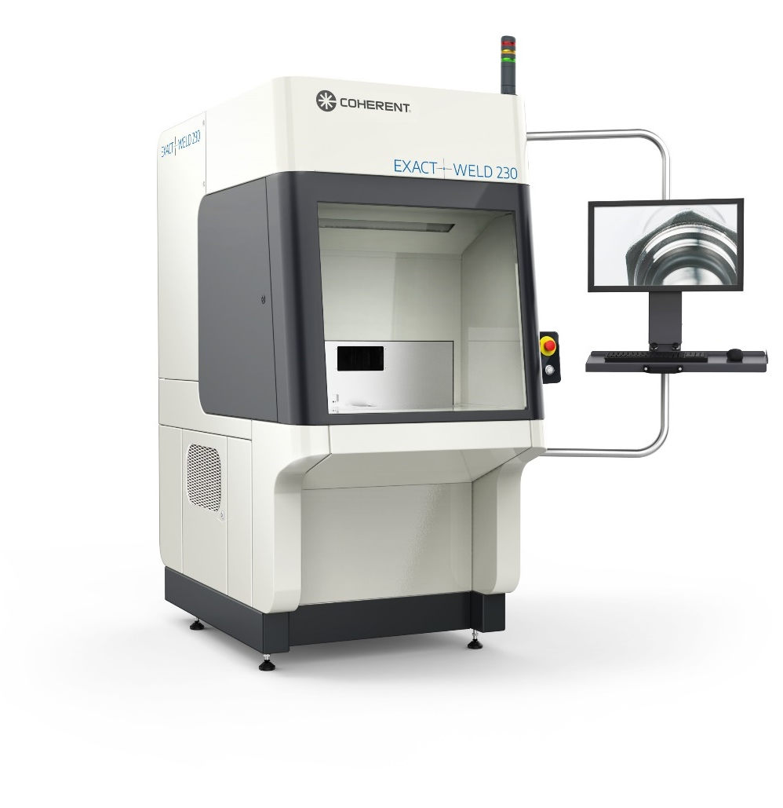
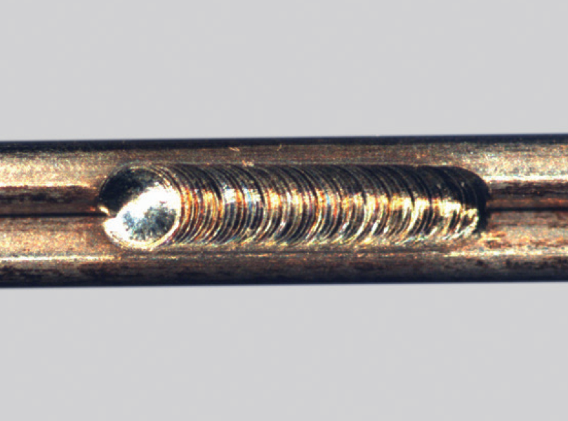
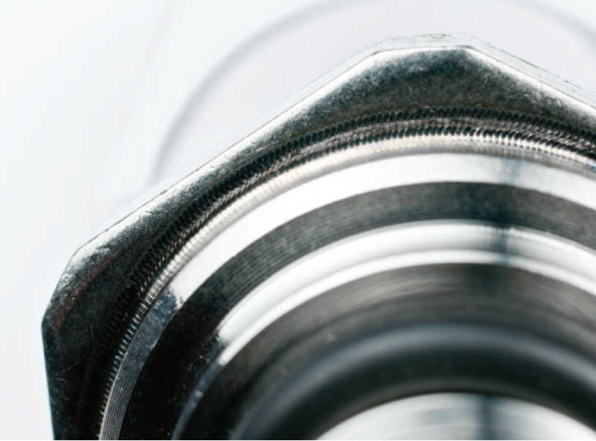
ExactWeld – Precision Laser Welding System
SPECIFICATIONS
Integrated laser source StarFiber (200 W / 400 W)
Highly efficient CW fiber laser
Wide range of optics for laser fine-welding applications
Optional rotary axis with up to 500 rpm
Optional CCD Camera with integrated crosshair

Slide 18
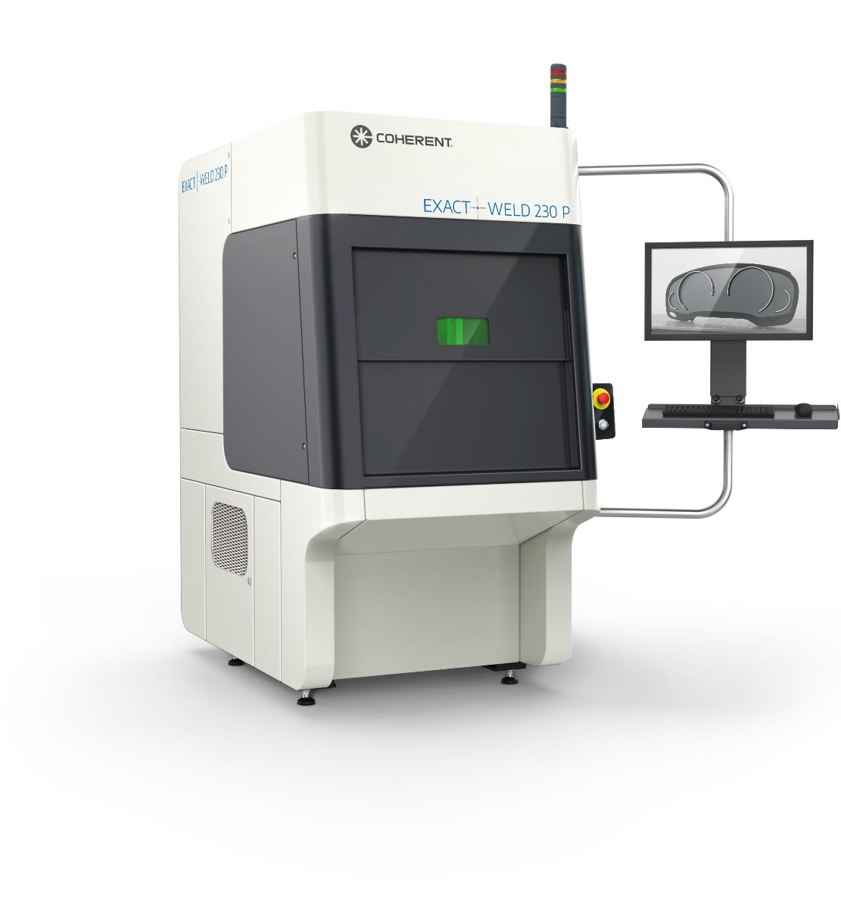
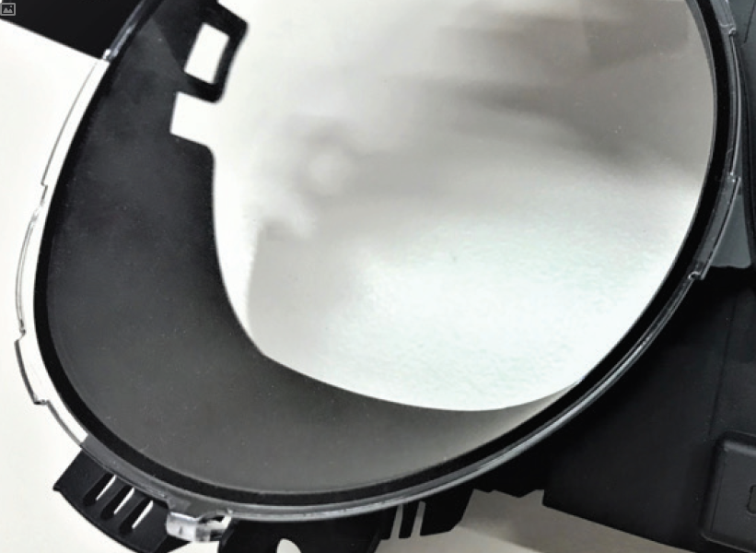
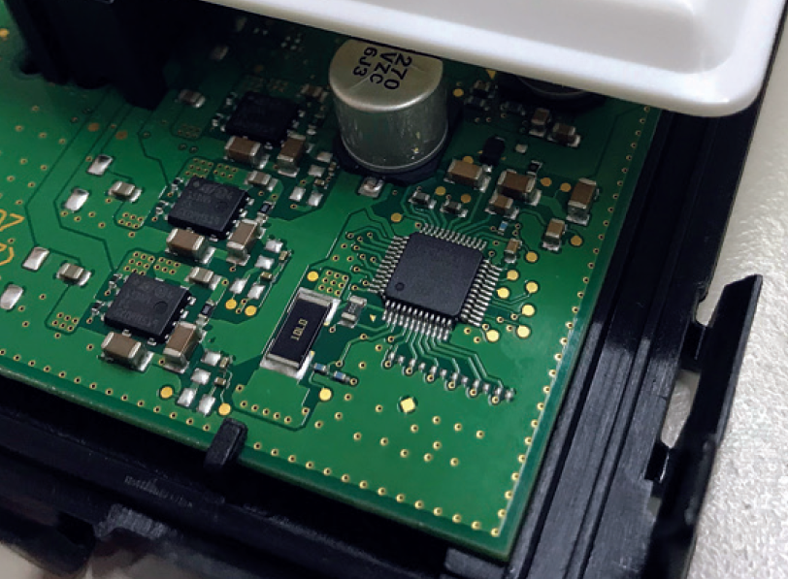
ExactWeld P – Polymer Laser Welding System
SPECIFICATIONS
Integrated laser source Compact Evolution (300 W)
Highly efficient CW diode laser
Homogeneous beam profile for polymer welding
Sophisticated Polymer Welding Control
Easy configurable touchscreen HMI
Optional thermal vision check

Slide 19
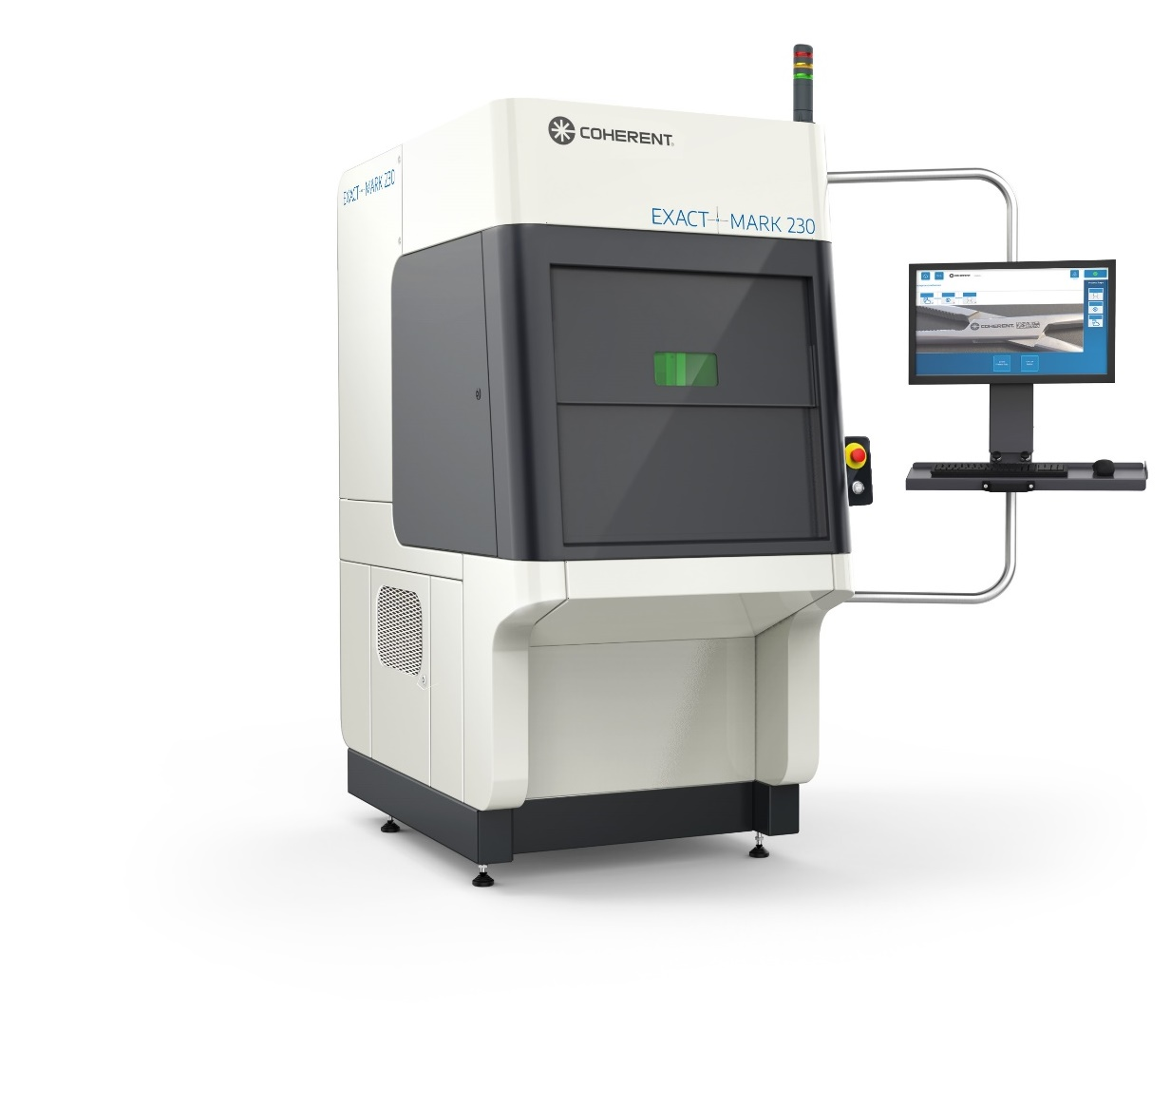
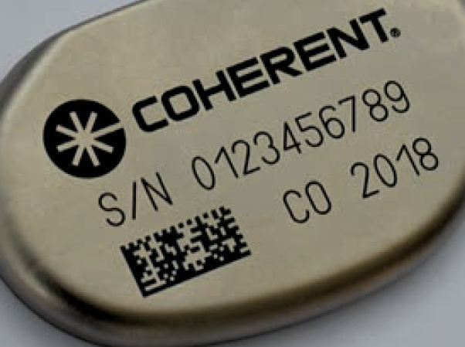
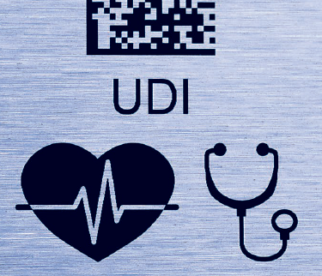
ExactMark 230 / 210 – Precision Laser Marking Systems
SPECIFICATIONS
High-contrast marking
Applicable on fragile parts due to minimal thermal stress
Various servo axes for positioning, motion, and focal height adjustments
Various materials from metals to plastics
Easy-to-use software “Visual LaserMarker” (VLM)
Control via an easy-to-use GUI with a 24” touch screen monitor

Slide 20
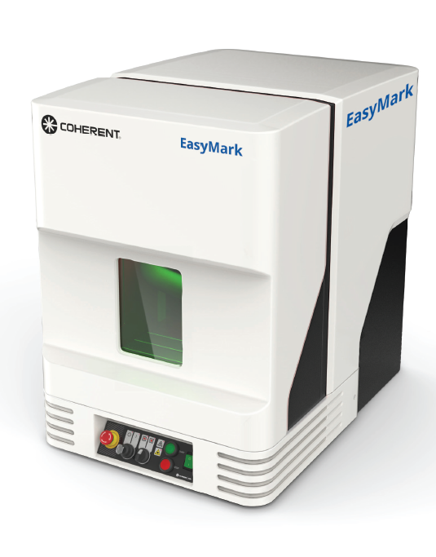

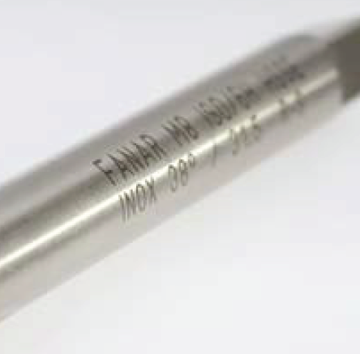
EasyMark | EasyJewel
CONFIGURATION
Easy operation due to graphical user interface
Spacious working chamber
Low maintenance and service costs
On-The-Fly engraving
OPTIONS
SmartViewTM
Rotation axis
Exhaust unit including remote start

Slide 21
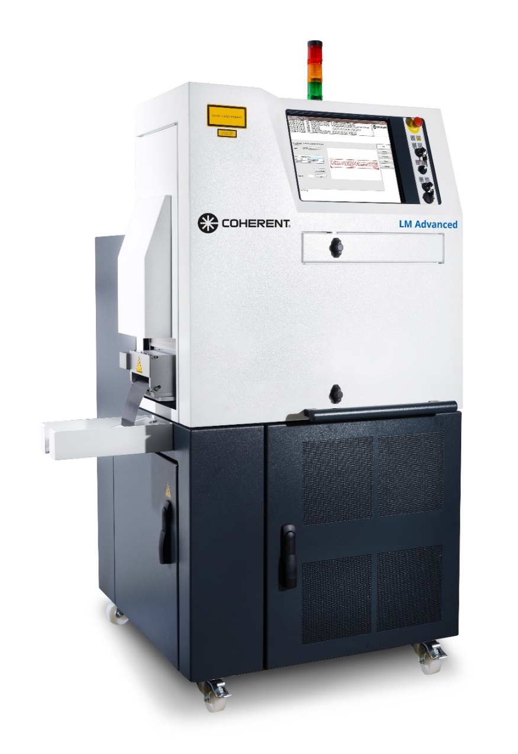

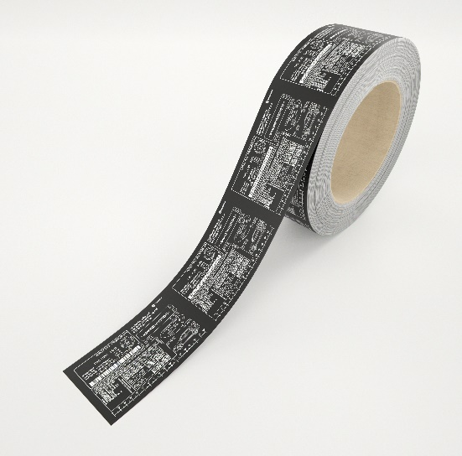
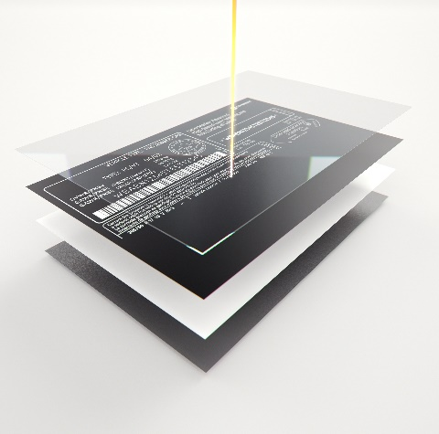
LabelMarker Advanced
CONFIGURATION​
Economic footprint​, integrated all-in-one system
Integrated foil unit for transportation​
All common laser label materials Splice detection
Object orientated layout design software VLM (Visual Laser Marker)
Automatic foil cutting and foil end warning
Easy link to master execution systems

Slide 22
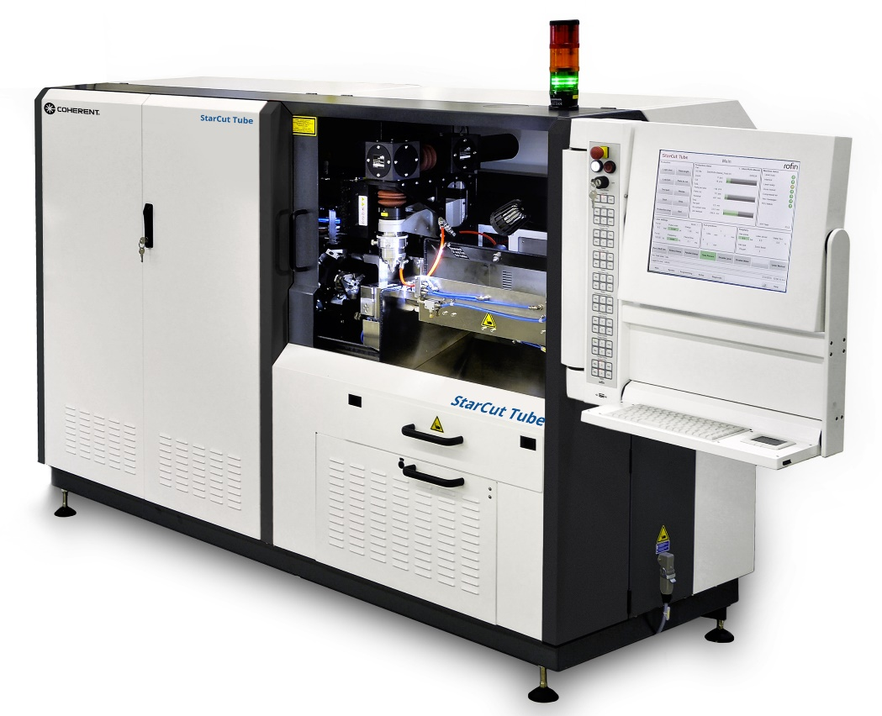
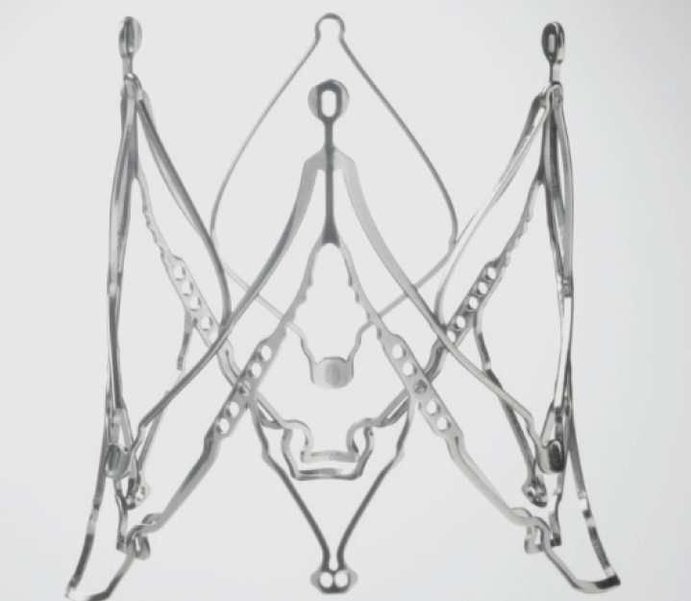
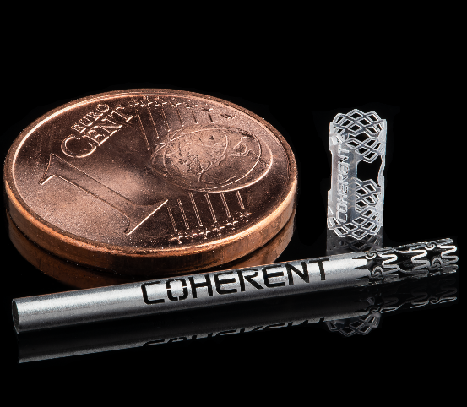
StarCut Tube Family
SPECIFICATIONS
High precision cutting system for medical implants (e.g. stents) or instruments
Flat cutting option
Tube diameter up to 30 mm
Available with 2, 3 or 4 axes
Can cut struts smaller than a human hair
Also available with ultra-short pulse and fiber laser in one housing

Slide 23
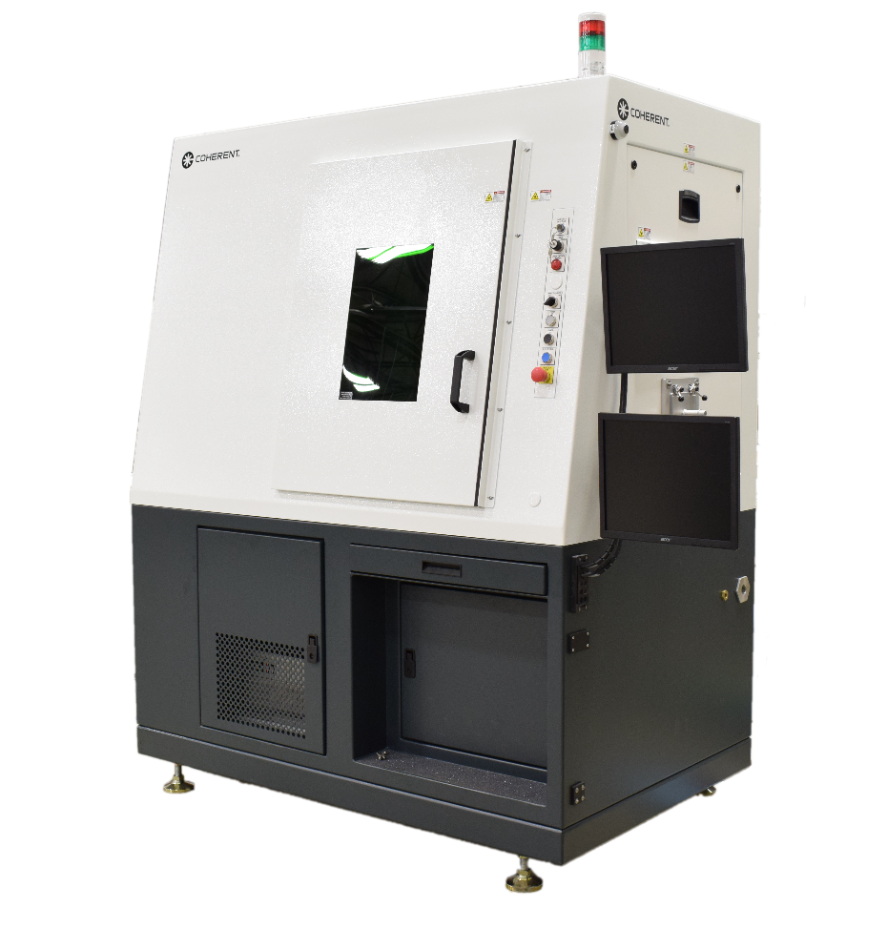
UW - Universal Workstation
CONFIGURATION​
UW 180 - workstation for cutting with sliding door or auto-door, or as an open frame class 4
UW 1200 - 3- to 5-Axis work-station for precision 2D and 3D laser processing of parts up to 50 lbs (incl. fixture)
UW 150 PW - small footprint for welding of polymers
UW 1600 - robot assisted cutting and welding / high volume manufacturing system - can be integrated in existing production line

Slide 24










Manual Welder Family
WELDER WITHOUT AXES
WELDER WITH AXES
Manual welding of small to bigger sized pieces
60 W up to 150 W power
Manual welding up to full CNC automation
100 W up to 400 W power

Slide 25




Desktop - Manual Welder Without Axes
Power upgrade 100 W / 80 J
SPEEDmode™
BURSTmode™
CONFIGURATION
Color TFT touch display
Leica microscope
TrueView™
ECOmode™
Weld assist systems

Slide 26


Performance Basic - Manual Welder Without Axes
Power upgrade 150 W / 100 J
SPEEDmode™
BURSTmode
Dynamic foot switch
CONFIGURATION
laser resonator®
Leica microscope
TrueView™
ECOmode™
Reliable 24/7 operation
Integrated HEPA exhaust (optional)

Slide 27

Performance Family - Manual Welders Without Axes
Integrated HEPA exhaust
Rotation axis (optional)
Dynamic foot switch (optional)
CONFIGURATION
laser resonator®
MicroWeld™ (optional)
Leica microscope, TrueView™
SPEEDmode™, etc.
Reliable 24/7 operation

Slide 28



Select - Manual Welders With Axes
CONFIGURATION
Teach-In functionalities
4-axes joystick box
SynchroWeld™ and look ahead
Multi-touch display
Nd:YAG laser resonator®
12kW peak
MicroWeld™
SPEEDmode™: up to 200 W
Fiber laser
1.5kW peak
Pulsed: 150 / CW: 250 W

Slide 29
Integral - Manual Welders With Axes
CONFIGURATION
MicroWeld™ and SweetSpot resonator®
Teach-In functionalities
Joystick box
SynchroWeld™ and look ahead
Multi-Touch Display
Nd:YAG resonator®
up to 400 W with SPEEDmode
Swivel-optics (optional)
Up to 500 kg workload (optional)

Slide 30

Software – Smart, Powerful, Intuitive
Powerful and intuitive operating environment with integrated Coherent CAD/CAM software
Smart monitoring with cutting-edge sensor technology, and integrated system and process diagnostics – IIoT ready
Predictive maintenance using smart-monitoring technology
Return To Operations (RTO) quickly with remote diagnostics
MES and ERP systems compatible

Slide 31




Welding
SmartWeld +
FREEFORM WELDING
From simple to very complex geometries. Individual designs, prototypes and single production
SPOT WELDING
Fine welding with spot diameter to 100 μm
SEAM WELDING
Small seam geometries at high welding speeds resulting in maximum strength with minimum thermal input
SEAL WELDING
Zero porosity and crack-free seams create hermetic joints

Slide 32




Cutting & Drilling
FLAT SHEET CUTTING
From simple to very complex geometries and sizes
2D AND 3D CUTTING
Superb edge quality
and reduced postprocessing
BRITTLE MATERIAL
Crack, chip and oxide-free
edges on glass and ceramics such as sapphire
DRILLING
Precision holes, e.g. for injection nozzles in the automotive industry or needle holes in medical device technology

Slide 33




Marking
PLASTICS MARKING
Color and surface modification of various plasics for fine, high-resolution marks
METAL MARKING
High contrast and abrasion-resistant marking by engraving, annealing or surface modification
PCB PROCESSING
Marking matrix codes with high accuracy and minimal heat input
DAY & NIGHT MARKING
Selective removal of specific lacquer layers from multilayer-coated transparent parts

Slide 34




Surface Treatment
ABLATION
Removing individual layers without damaging the layers or substrates below
SCRIBING
Forming kerfs for separating semiconductors and ceramics, or selective weakening of individual layers, e.g. burst disc calibration
ENGRAVING
Deeper ablation process for making high-precision printing, embossing, abrasive, or injection tools
CLADDING
Ideal for repairing and touching up workpieces or for tool and component protection against wear or corrosion.

Slide 35






Center of Excellence – Your Application in Focus
Consult with people who truly understand your application.
Long-term experience in many different end-user production environments.
The skills and resources to optimize the specifics of the application.
On-site support of machine integration into the production environment.
Comprehensive training by experts in your application.
Coherent’s expansive customer service organization covers the globe.

Slide 36
Coherent Sub-Systems and Systems – Your Benefits
High-quality, application-driven system solutions
Decades of deep process know-how and innovation
Turnkey solutions, including hardware, software and process technology
Industry-leading, comprehensive training, support and service solutions worldwide

